Slide 1

Lohas Park Fintech Consulting
HSI Investing Tool
Group2
Chen Hongyu, Hao Xinyu, Wang Keyang, Wang Yiduo, Tang Yufan, Zhang Yue

Slide 2
Lohas Park FinTech Consulting
Introduction
Agenda
What the product provide? How does the model work?
Model Formation
Data preprocessing & variable calculation
Regression and prediction model
Investing Strategy
Sample and Visualization
Limitation & Conclusion
Introduction
Data Preprocessing
Data Exploration
Model Fitting
Long-Short Strategy
6%
Notes:
Our presentation covers four main parts, firstly I will run you through a basic introduction of what is this product and how is it built. Then Tiffy and Alex will explain the mechanism of our model in details. To put the model into practice, Vincent will show you how we use the predicted price to generate investment strategies. Finally, the limitation and conclusion will provide you with a fuller picture of our product.

Slide 3

Lohas Park FinTech Consulting
About the tool
HSI Investment Tool is a model that utilizes the time difference in incorporating new information between option market and stock market to estimate the equity performance trend ahead of time.
Introduction
Data Preprocessing
Data Exploration
Model Fitting
Long-Short Strategy
11%
5%
Notes:
So, what is this tool? As Yuhuang Xing mentioned in his report, option market tends to incorporate new information faster than equity market since informed investors tend to speculate or hedge using options. We utilize this time difference by extracting factors from option markets to make prediction for equity prices.

Slide 4
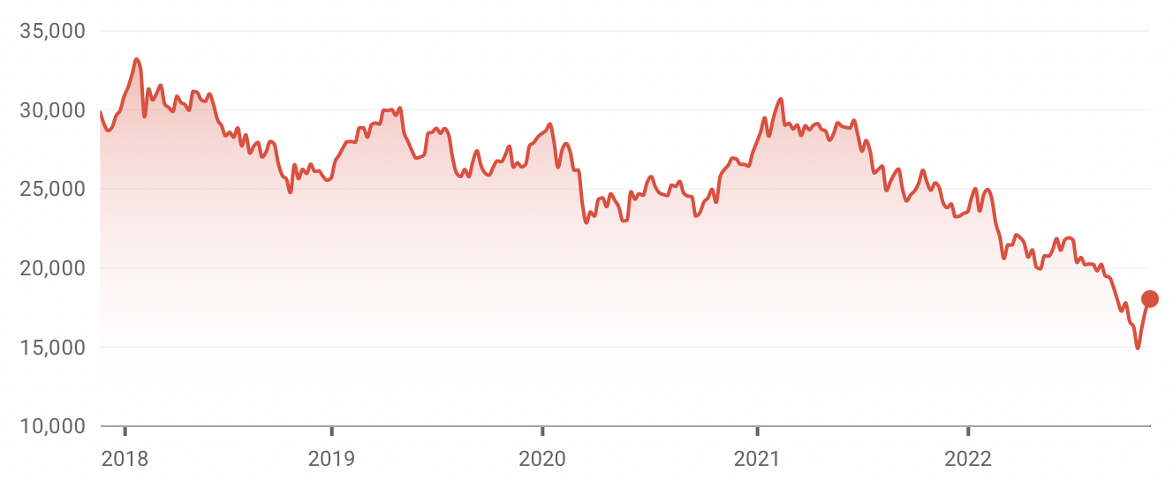






Lohas Park FinTech Consulting
What do we use
Underlying asset
HSI Index
Trading Range and Volume
14,597.31 - 25,099.95
52 weeks
2,411,957,106
In this model, we utilise skew of the volatility smirk to simulate future index performance since it reflects the change in supply and demand of the index options through implied volatility (Yuhang X, et al, 2010).
As the degree of predictability is substantially larger when option liquidity is high and stock liquidity is low (Martijn C, 2010), the HSI index should be a good fit for people tends to speculate it using option rather than ETF.
Introduction
Data Preprocessing
Data Exploration
Model Fitting
Long-Short Strategy
18%
5%
Notes:
This prediction model tends to be more accurate with higher liquidity in options and lower liquidity in stocks
\.

Slide 5
Lohas Park FinTech Consulting
How is the tool built
STEP 1
STEP 2
Data Preprocessing
Data Exploration
HSI adjusted price data set
Option volatility data set
Calculate SKEW as a new variable
Observe the movement of skew when time passes
Validate the relationship between skewness and future stock performance
STEP 4
STEP 3
Long & Short Strategy
Model Fitting
Enter/stay in long position when the predicted price is above the current price
Enter/stay in short position when the predicted price is below the current price
Fama-MacBeth Regression model
Regression analysis
Prediction using the regression model
Introduction
Data Preprocessing
Data Exploration
Model Fitting
Long-Short Strategy
25%
5%
15%
Notes:
After confirming the predictivity of skewness, we can then construct our own prediction model. Our model took intuition from the fama-MacBeth regression model which measures how correctly the risk factors explain asset returns.

Slide 6

Lohas Park FinTech Consulting
Data Processing
Introduction
Data Preprocessing
Data Exploration
Model Fitting
Long-Short Strategy
25%
31%
5%
15%

Slide 7


Lohas Park FinTech Consulting
ATM & OTM
How do we define:
K
Ratio of
St
K = strike price
St = stock price
Our tool to illustrate:
If K/St = (0.80,0.95): OTM put option
If K/St = (0.95,1.05): ATM call option
Introduction
Data Preprocessing
Data Exploration
Model Fitting
Long-Short Strategy
31%
Notes:
Before we go through the detail of the model, we would like to introduce you some basic concepts.
I will firstly introduce at the money and out of the money, ATM means that for both call and put option, strike price is equal to current asset price. And for OTM, it means that strike price is greater than current asset price when it is a call option. On the country, if it is a put option, strike price is smaller than current asset price.
Here we refer to the method of the article, so our definition is k/st, k is the strike price and st is stock price. If the ratio is between 0.8 to 0.95, it is an OTM put option. If the range is between 0.95 to 1.05, it should be an ATM call option. Our group is based on this data to illustrate.

Slide 8

Lohas Park FinTech Consulting
Series Recode
Expiration Month Codes
Month | Call | Put
January | A | M
February | B | N
March | C | O
April | D | P
May | E | Q
June | F | R
… | … | …
HSI 21000 A0
21000
Strike Price, K
Introduction
Data Preprocessing
Data Exploration
Model Fitting
Long-Short Strategy
37%
Notes:
Here is the example of the series, 21000 in the middle means strike price. And the picture on the right shows the expiration month code. for example, letter A and letter M represent the call and put option of January respectively.

Slide 9

Lohas Park FinTech Consulting
Processing Skew
1
2
Create 12 groups of skew by months
Select those issued 10-60 days before maturity
Month | Call | Put
January | A | M
February | B | N
March | C | O
E.g.
Maturity date: Jan 31, 2021.
Issue dates: Dec 2, 2020, to Jan 21, 2021.
Introduction
Data Exploration
Data Preprocessing
Model Fitting
Long-Short Strategy
44%
Notes:
Here is the skew grouping method. We firstly fix the maturity date, then crate 12 groups of skew by months. In the article named “xingzhangzhao”, the paper points out that the difference of the issue date and the maturity date is around 10 to 60 days. So，For example, if the maturity date is Jan 31, 2021. the issue dates should between Dec 2, 2020, to Jan 21, 2021.

Slide 10
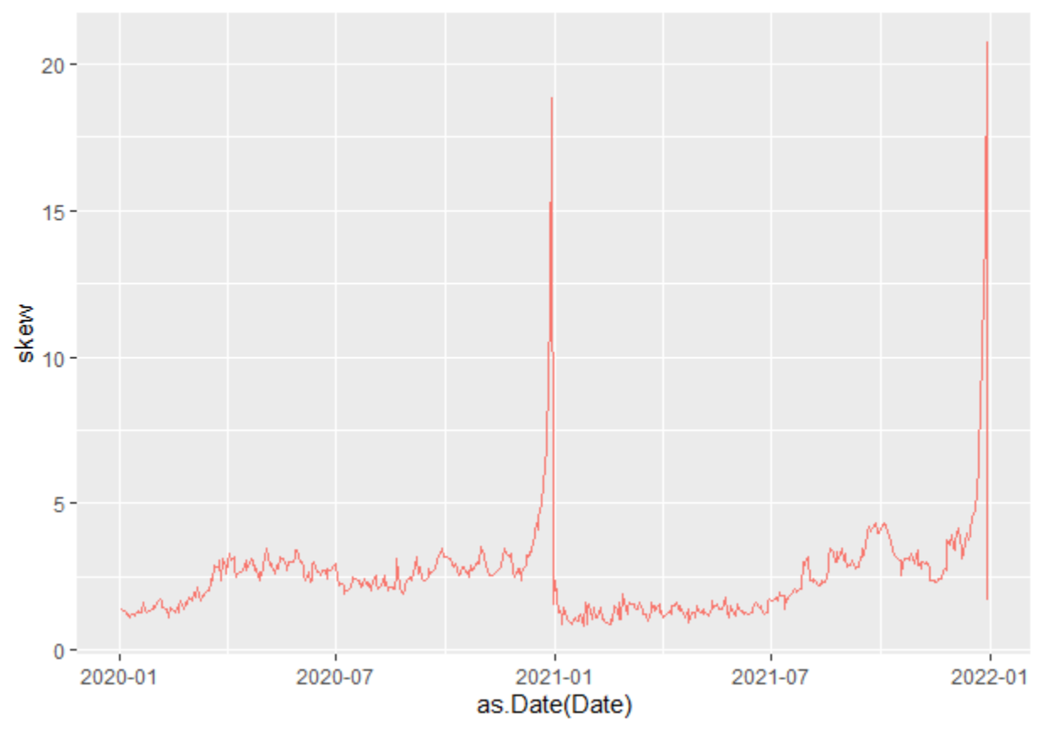
Lohas Park FinTech Consulting
Skew
CALCULATION:
SKEW = Implied Volatility of OTM put
-
Implied Volatility of ATM call
Introduction
Data Preprocessing
Data Exploration
Model Fitting
Long-Short Strategy
50%
Notes:
Since we have formed 12 groups, we can calculate skew now.
According to the article we know that Implied Volatility of OTM put minus Implied Volatility of ATM call. We further plot the skewness over the time, take month 12 as an example, which proves that as skew increases, the future underlying prices decreases in Yahoo Finance.

Slide 11
Lohas Park FinTech Consulting
Prediction Methods
Introduction
Data Preprocessing
Data Exploration
Model Fitting
Long-short Strategy
Limitation & Conclusion
56%
Notes:
Now I will introduce our prediction methods

Slide 12
Lohas Park FinTech Consulting
Linear Regression Model
Based on the Fama–MacBeth Regression Model:
Price_{t+7} = b₀ + b₁*Skew_{t} + b₂*Monthly Effect_{t} + b₃*Volume_{t}
Dependent Variable
Price: HSI adjusted price(yahoo finance)
Independent Variables
SKEW: OTM Put – ATM Call
Monthly Effect: Refers to the issuance month when we observed the Skew
Volume: Refers to the trading volume daily when we observed the Skew
Data Preprocessing
Data Exploration
Model Fitting
Long-short Strategy
Limitation & Conclusion
20%
56%
30%
35%
40%
5%
15%
Notes:
From the previous analysis by Yvette, we can see that skew have a close relationship with the price of the stock.
Therefore, our group did a linear regression model on the Hang Seng Index. The dependent variable is Hang Seng Index adjusted price downloaded from yahoo finance.
The first independent variable is SKEW which is calculated by the implied volatility difference between out of the money put option and at the money call option.
Since our regression model is based on the Fama–MacBeth regression model, we also use another two variables, the monthly effect which refers to the issuance month when we observed the Skew. And also, the volume is downloaded from yahoo finance which refers to the trading volume daily when we observed the Skew

Slide 13
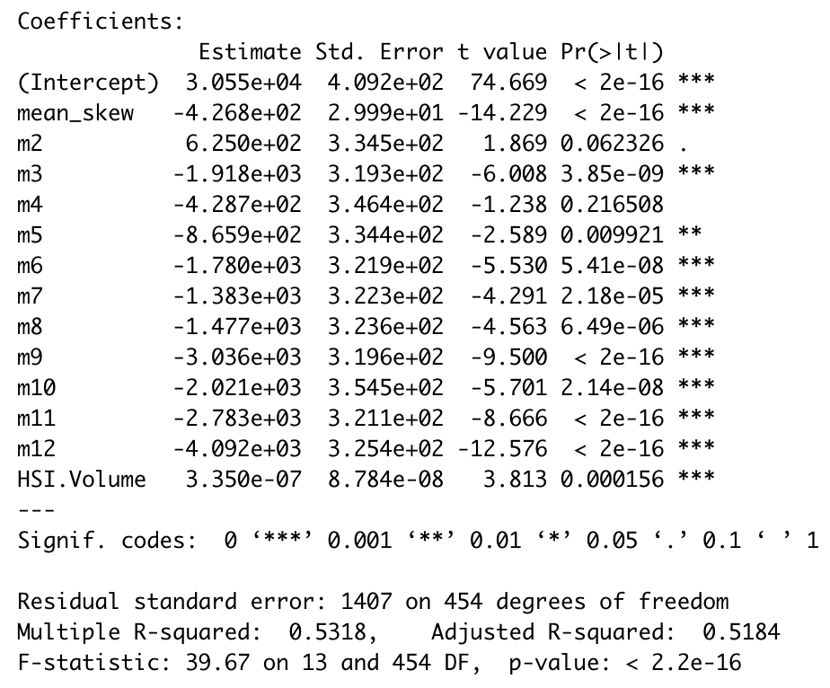
Lohas Park FinTech Consulting
Regression Model Result
​ | SKEW​ | Monthly Effect​ | Volume
P value​ | < 2.2e-16​ | Refers to the graph​ | 0.000156
Signif. codes​ | Significant | Significant except m2 and m4​ | Significant
Relation with HSI price | negative | Refers to the graph​ | positive
The Brief Percentage of CAC
468 Observations
Adjusted R-squared: 0.5184
F-test, p value: < 2.2e⁻¹⁶
Data Preprocessing
Data Exploration
Model Fitting
Long-short Strategy
Limitation & Conclusion
20%
62%
30%
35%
40%
5%
15%
Notes:
Now lets see the result of our regression model. We can see that the p value skew and volume is pretty small which means they are quite significant. The coefficient of skew is -426 and we see that the future price of the heng seng index is negatively related to skew.
However, for the month effect, we can see they are overall quite significant other than the month of February and April.
We guess that the price trend of stock during this time may be abnormal and difficult to predict due to the epidemic. But in general, the issuance month will still affect the future stock price trend.
And also, the p value of f test is quite small and the adjusted r square is also quite reasonable. The shows our regression model is reasonably reliable.

Slide 14
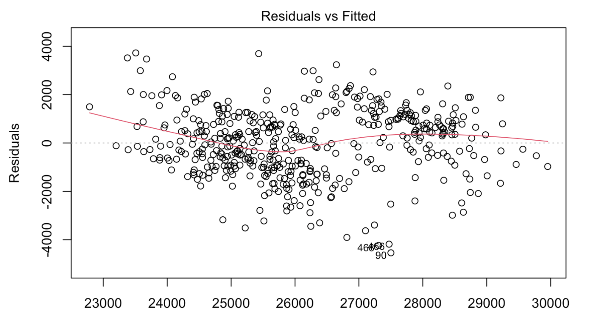
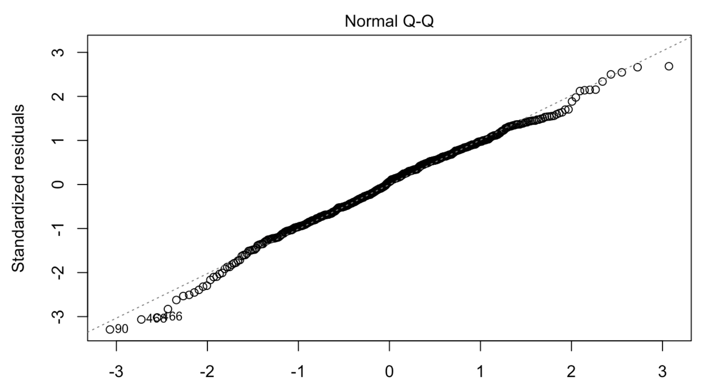

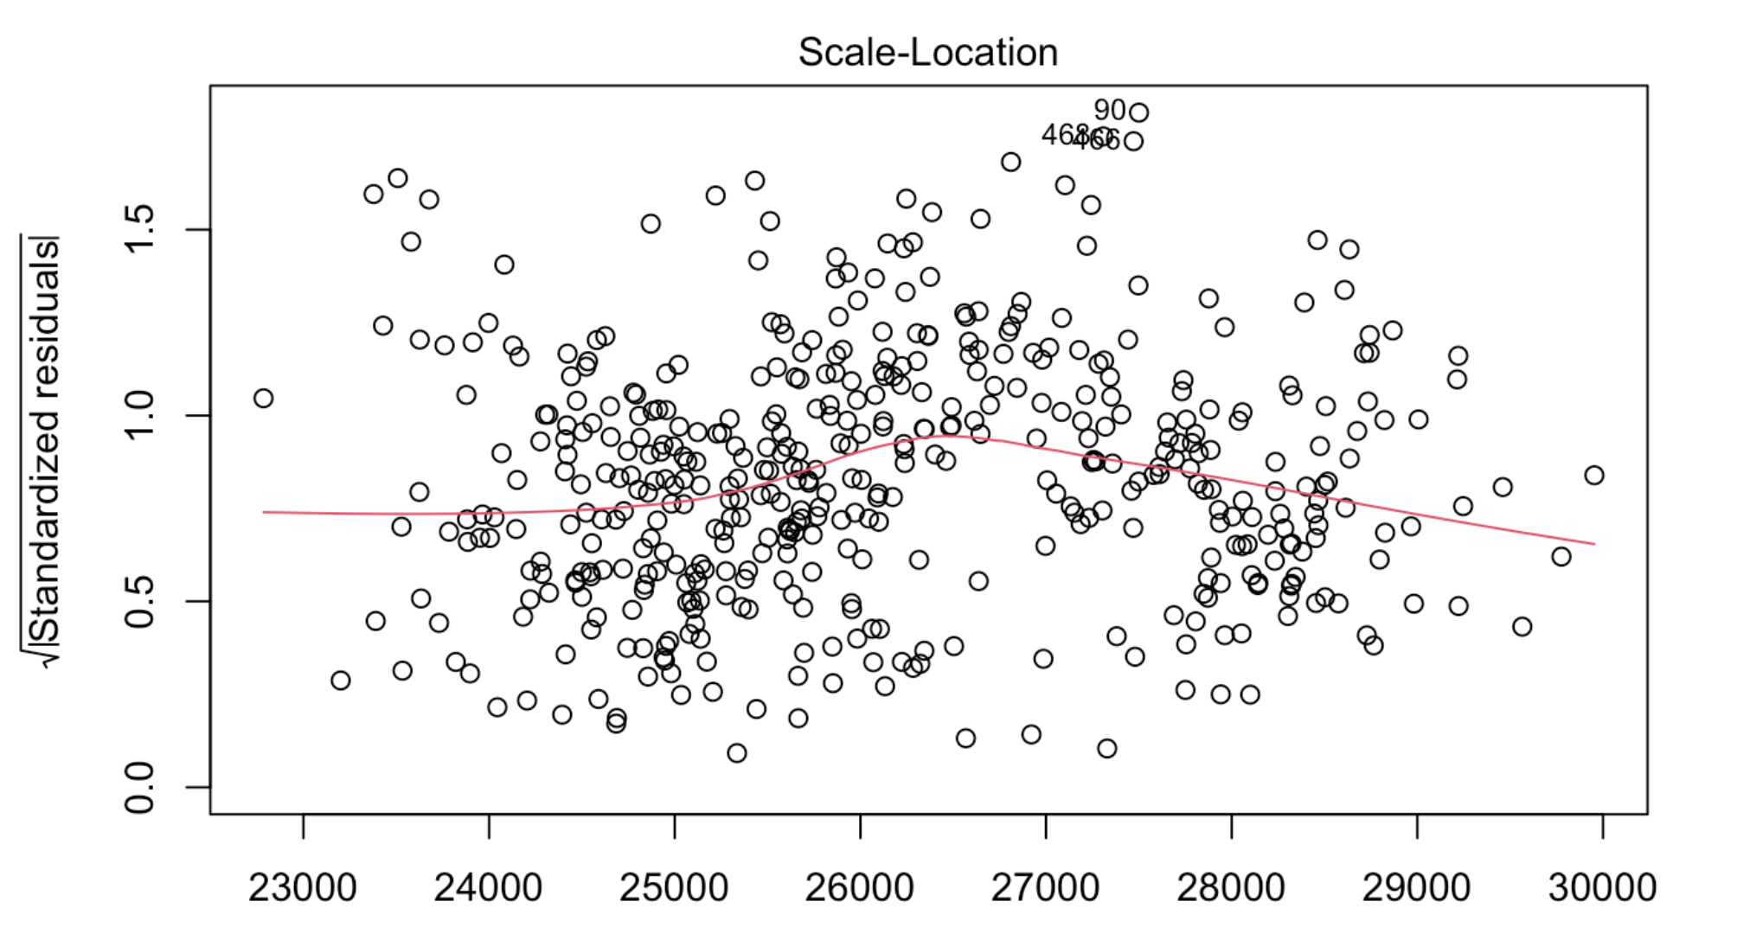
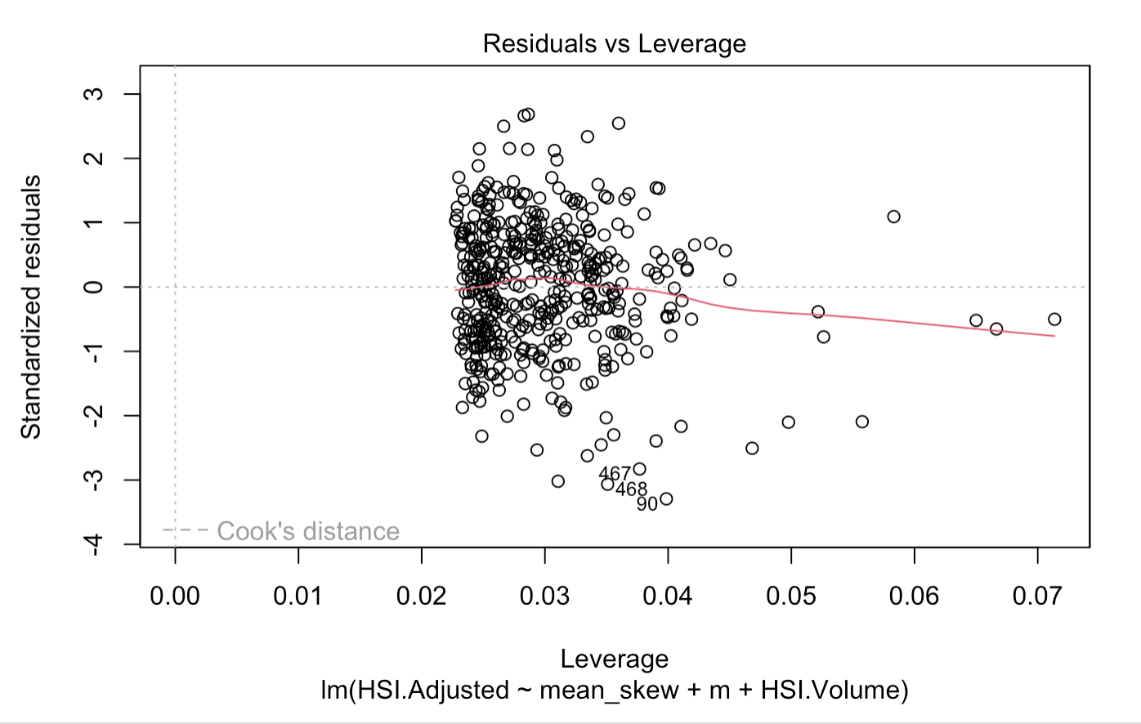
Lohas Park FinTech Consulting
Diagnostic Plots for Regression Analysis
Linearity
Normality
Constant Variance
No Influential cases
Data Preprocessing
Data Exploration
Model Fitting
Long-short Strategy
Limitation & Conclusion
70%
30%
35%
40%
5%
15%
Notes:
Now, lets take a look at the diagnostic plots for regression annlysis.
For the residuals vs fitted plot, we can see that there is non linear trend
For the second plot, it is near the theoretical line And for the scale-location, residuals are spread equally along the ranges of predictors.
And for the last plot,and there are no influential cases.
Overall, the Diagnostic Plots shows that our regression model meets the assumption

Slide 15
Lohas Park FinTech Consulting
Long-Short Strategy
Data Preprocessing
Data Exploration
Model Fitting
Long-short Strategy
Limitation & Conclusion
70%
30%
35%
40%
5%
15%

Slide 16
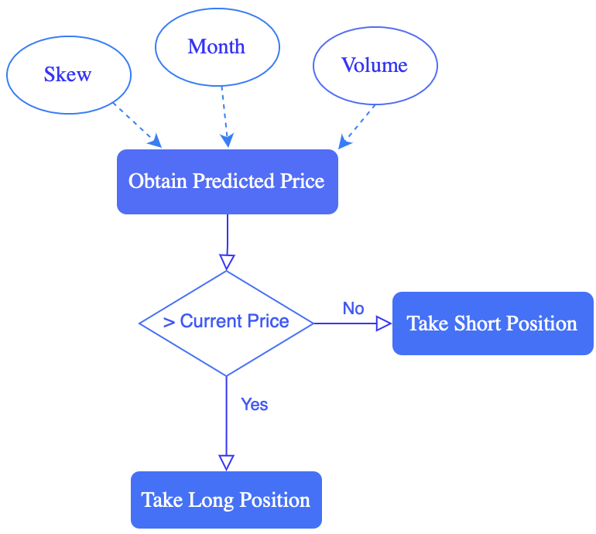


Lohas Park FinTech Consulting
Product Strategy
Should I
invest now?
We'll offer you the strategy!
Data Exploration
Model Fitting
Long-Short Strategy
Limitation & Conclusion
76%
30%
35%
40%
5%
15%
Notes:
After receiving a request from a customer, we find out the current skew value and take into account the month and trading volume in which the customer pulled out the request. Then we use these two factors to make a forecast about the stock price of the HSI.
Our Strategy is to use three variables skew, month. Volume to predict the future price. If the future predicted price is larger than the current price, long it. Otherwise, short it.

Slide 17
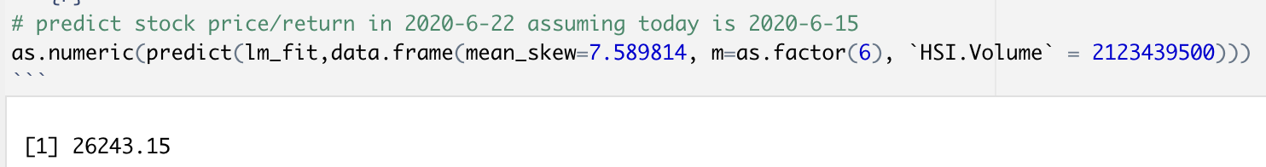

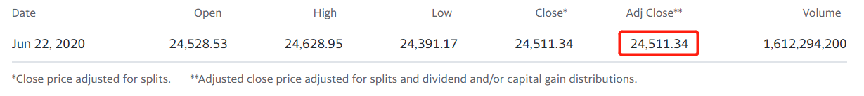
Lohas Park FinTech Consulting
Real Example
What position to take on June 15, 2020?
Our Tool
Since the predicted price > current price
Take Long Position!
Yahoo Finance
Data Exploration
Model Fitting
Long-Short Strategy
Limitation & Conclusion
82%
30%
35%
40%
5%
15%
Notes:
(Marvin asks the question)
Good question! Let’s assume we are on 2020-06-15 and want to know whether we can buy HSI now. Firstly, from Yahoo.finance, we know the actual price on 2020-06-15 was 23776.95. After processed by the regression model for which we input skew, monthly effect and volume, the price is predicted to be around 26243.15.
While the price on June 15 is 23776.95, so we strongly recommend a long strategy to you.
Now let's verify the accuracy of our model. Overserving the actual price on June 22 is 24511.34 from Yahoo finance. Both the predicted price and the actual price support our decision. The strategy we made is correct!

Slide 18
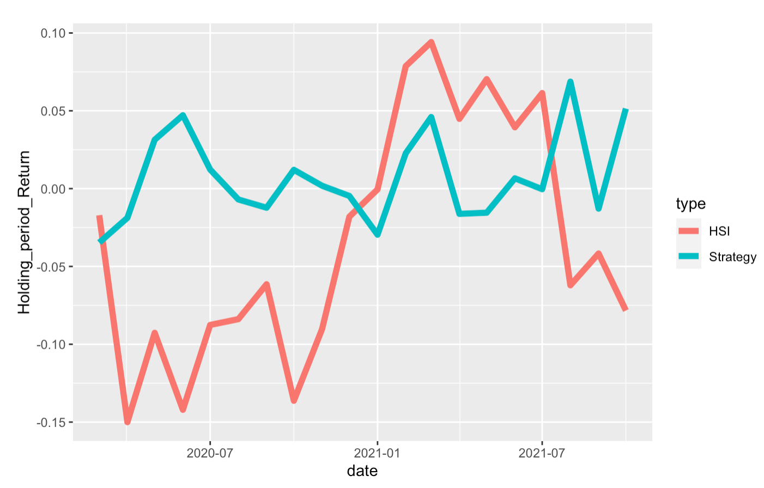
Lohas Park FinTech Consulting
Product Performance
Holding period
Holding HSI
Our product
20 months
-7.83%
5.14%
Difference in the Prediction Price and HSI Price
Under 95% Confidence Interval
(-397HKD, 186HKD)
Tolerance of Our Model and HSI Price
(-1.50%, 0.70%)
Data Exploration
Model Fitting
Long-Short Strategy
Limitation & Conclusion
90%
30%
35%
40%
5%
15%
Notes:
Next, let's see the performance of our product. We compared the holding period return with keeping HSI and our strategy. The red line is the return we keep holding HSI and the blue line is the return by our strategy. We can see from this chart that the return is more stable and reliable under our strategy.
If you keep holding HIS for 20 months, you might lose -7.83%. However, if you turn to our strategy, you can generate a return of 5.14%! Isn’t that amazing?
Under 95% confidential interval, the difference will float between around –397HKD to 186HKD. And the tolerance of our prediction model compared to actual HIS prices is between -1.5% and 0.70%.

Slide 19

Lohas Park FinTech Consulting
Limitation
Missing data
Black swan event (COVID-19)
Generalization ability
Model Fitting
Limitation & Conclusion
Long-Short Strategy
96%
30%
35%
40%
5%
15%
Notes:
Though the tool looks magical, it does have some limitation.
First of all, some data in the dataset which we built the tool on is missing. This causes some inaccuracy, though not too much.
Second, there exists bias in the stock performance in 2020, which is mainly caused by Covid-19, financial and political issue.
Last but not least, the regression model is designed for 2020-2022. Whether future prices can be reasonably measured is still unclear. So one of the most important thing is the data needs to be up-to-date!

Slide 20





Lohas Park FinTech Consulting
Conclusion
Data Cleaning
Data Process
Linear Regression
Product Strategy
Performance Evaluation
A tool continuously offers strategy for a 7-day prediction is developed!
CEO
CBO
Some other methods? Machine Learning? More factors?
Ivy Zhang
Tyffy Tang
Yvette Wang
Notes:
Now comes the conclusion. In this project, our group developed a tool that helps decision analysis of whether we should buy HSI.
Based on the paper, we studied basic concepts such as smirks and skew. Particularly, how increasing skew infers the future underlying bad performance.
Finally, we performed a linear regression on the data, and in the regression, we found that all the skew, purchase month and volume have high significance. Although the tool has some limitation, the regression results allow us to make a long or short strategy for the HSI after seven days with good accuracy.
In the future, we might add something new to our current product. For example, we might consider more factors and keep the data up-to-date. In the process of data, we might use some other methods such as machine learning to learn and train our dataset.

Slide 21


Lohas Park FinTech Consulting
CMO
Our Super Team
CEO
CEO
COO
CBO
Ivy Zhang
Alex Hao
Marvin Chen
Vincent Wang
Tyffy Tang
Yvette Wang
Notes:
This is our super team. Thanks Ivy, Alex, Marvin, Vincent and Yvette for your great teamwork.

Slide 22

Lohas Park FinTech Consulting
Q & A
We're here to help

Slide 23
Lohas Park FinTech Consulting
Reference List
CMO
Fama-MacBeth two-step regression method - SimTrade blog. (2022). Retrieved 21 November 2022, from https://www.simtrade.fr/blog_simtrade/fama-macbeth-two-step-regression-method/
Option naming convention - Wikipedia. (2011). Retrieved 21 November 2022, from https://en.wikipedia.org/wiki/Option_naming_convention
Yahoo. (2022). Retrieved 21 November 2022, from https://finance.yahoo.com/quote/%5EHSI?p=%5EHSI
Cremers, M., & Weinbaum, D. (2010). Deviations from Put-Call Parity and Stock Return Predictability. Journal Of Financial And Quantitative Analysis, 45(2), 335-367. doi: 10.1017/s002210901000013x
Xing, Y., Zhang, X., & Zhao, R. (2010). What Does the Individual Option Volatility Smirk Tell Us About Future Equity Returns?. Journal Of Financial And Quantitative Analysis, 45(3), 641-662. Retrieved from https://econpapers.repec.org/article/cupjfinqa/v_3a45_3ay_3a2010_3ai_3a03_3ap_3a641-662_5f00.htm
CEO

